Slide 1

MVC Design Pattern in ASP.NET Core
#12#
Design by: TEDU
Trainer: Bach Ngoc Toan
Website: www.tedu.com.vn
Facebook: fb.com/teduchannel
Please like videos and subscribe TEDU Channel to following the next video.

Slide 2
Overview
ASP.NET Core web apps are based on the popular MVC Design pattern.
MVC Pattern stands for Model-View-Controller Pattern.
In this Tutorial, we learn what is MVC and in the subsequent tutorial, we will see how to use MVC Design pattern in ASP.NET Core.

Slide 3
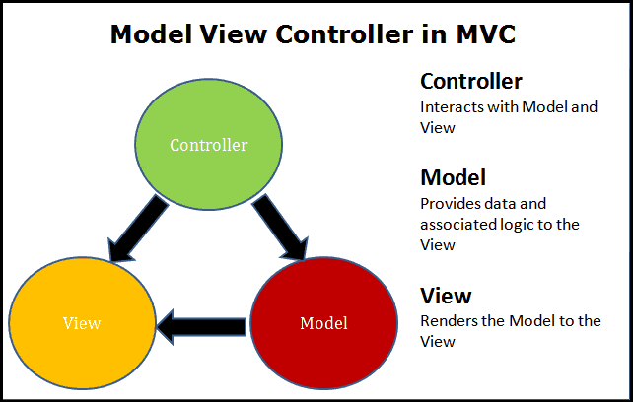
MVC Design Pattern in ASP.NET Core

Slide 4
Separation of concerns
The Separation of concerns philosophy states that each component of the application is responsible for only one thing.
They should do not depend upon any other component as much as possible.
In other words, the components should be loosely coupled with other.
The application built using such a concept is easily testable, maintainable and extensible.
The MVC Pattern follows the separation of concerns philosophy.

Slide 5
Model
The model represents the data that needs to be shown to the user and some associated logic.
It is an object or just another c# class with properties and methods.
The model does not and should not depend on Controller or View.
The only responsibility of the model is to hold the data.
The model class is ideally reusable.

Slide 6
View
The view is a visual representation of the model.
It is the responsibility of the View is to take the model from the controller, render and present it to the user.
A View has following responsibilities
Responsible for interacting with the User
Render the model to the user
Accept User interaction and pass it to controller
Consists of Standard HTML Pages / Javascript and CSS
Should be able to Render JSon, XML and custom return types

Slide 7
Controller
The Controller receives the request. It then builds the model and selects the view to display it.
It sits between View and the model.
You can think of it as a glue which joins Model to the View.
The Controller should not become a dumping ground for your code.
The Controller has following responsibilities
Process incoming requests from the user.
The controller then passes the request to appropriate Service layer gets the model.
Pass the model to view for rendering.
Passes the validations and errors back to View if any.
The controller never accesses the data layer.

Slide 8
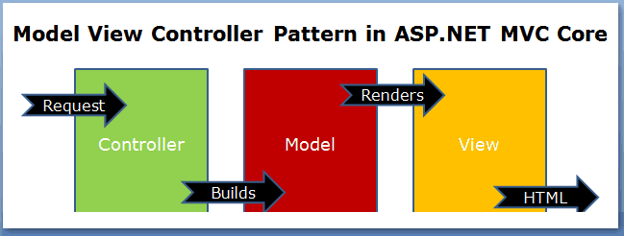
How MVC Pattern works in ASP.NET Core

